Slide 1


PoCUS and Radiology approaches to diagnosing arm DVT
Borsha Sarker
Research Sonographer
NIHR Leeds Biomedical Research Centre
#POCUSClubInternational
An easy, stepwise approach to an area that you might not feel entirely comfortable with scanning

Slide 2
What we will cover today
Anatomy refresher – upper limb and neck veins
Common reasons for referral
Clinical signs and symptoms
Pathology and differentials to consider
Live demonstrations of technique
Point of Care Ultrasound learning objectives.

Slide 3
Upper Limb DVT
Anatomy refresher – upper limb and neck veins
Common reasons for referral
Clinical signs and symptoms
Pathology and differentials to consider
Live demonstrations of technique

Slide 4
Upper Limb Deep Veins
Internal Jugular Vein
SVC (superior vena cava)
Brachiocephalic Veins (right and left innominate)
Subclavian Vein
Axillary Vein
Brachial Vein
Radial and Ulnar Veins

Slide 5
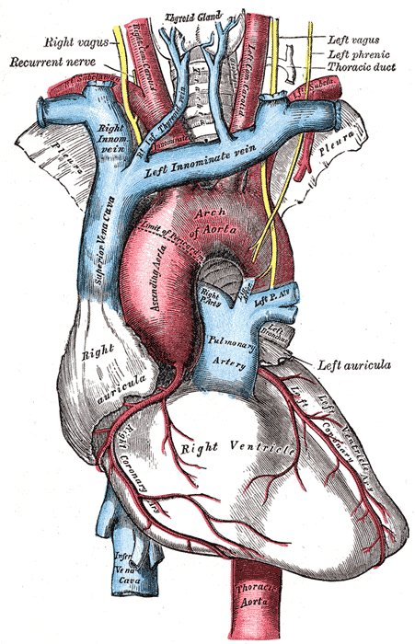
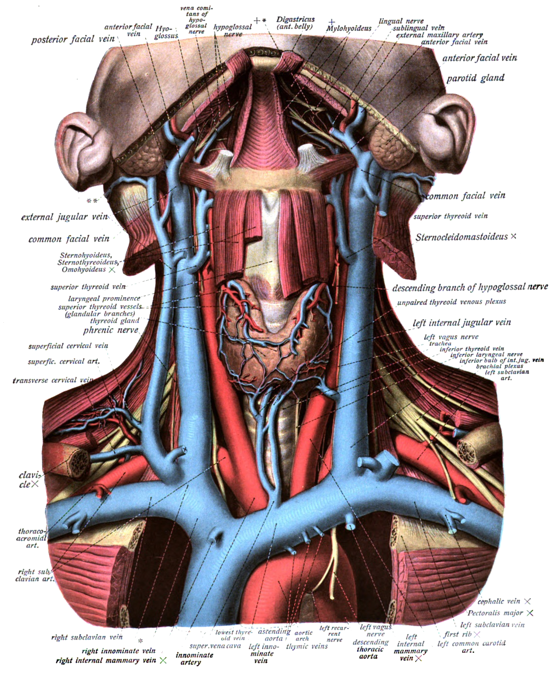
English: An anatomical illustration from Sobotta's Human Anatomy 1908
Date22 October 2013, 13:36:07SourceAtlas and Text-book of Human Anatomy Volume III Vascular System, Lymphatic system, Nervous system and Sense OrgansAuthorDr. Johannes Sobotta
https://commons.wikimedia.org/w/index.php?title=File:Gray505.png&oldid=391274599

Slide 6
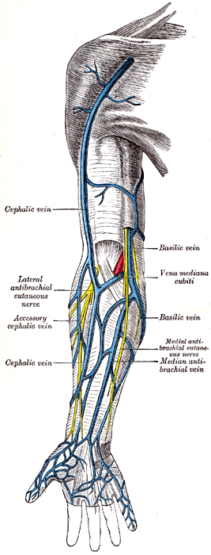
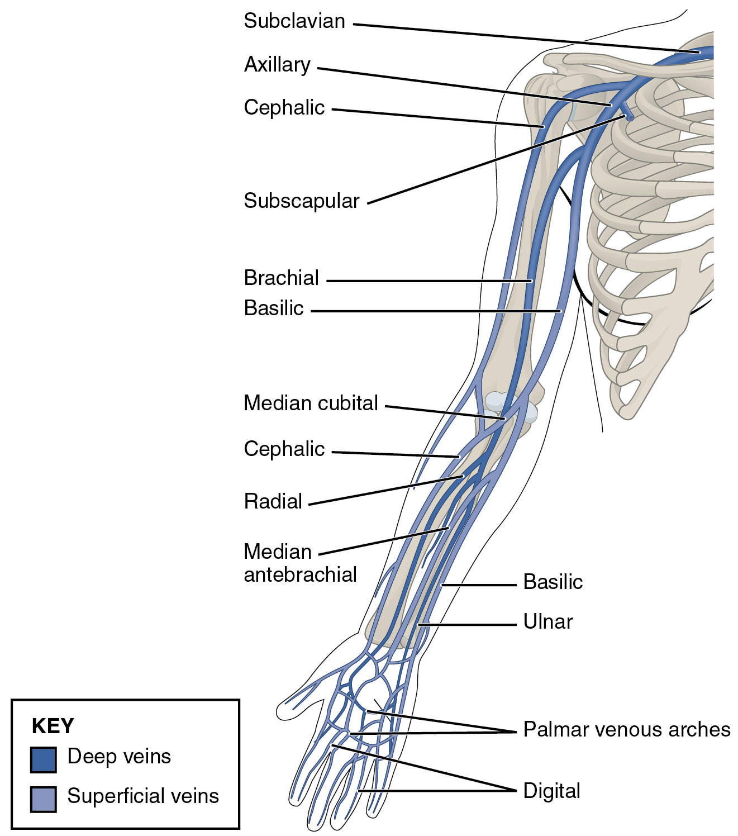
https://en.wikipedia.org/wiki/Basilic_vein#/media/File:2134_Thoracic_Upper_Limb_Veins.jpg
https://commons.wikimedia.org/wiki/File:Gray574.png

Slide 7
Upper Limb Superficial Veins
Cephalic Vein
- equivalent to the long saphenous vein
- variable anatomy, mostly size related
Basilic Vein
- equivalent to the short saphenous vein
variable anatomy, mostly related to insertion into brachial
Median Cubital Vein

Slide 8
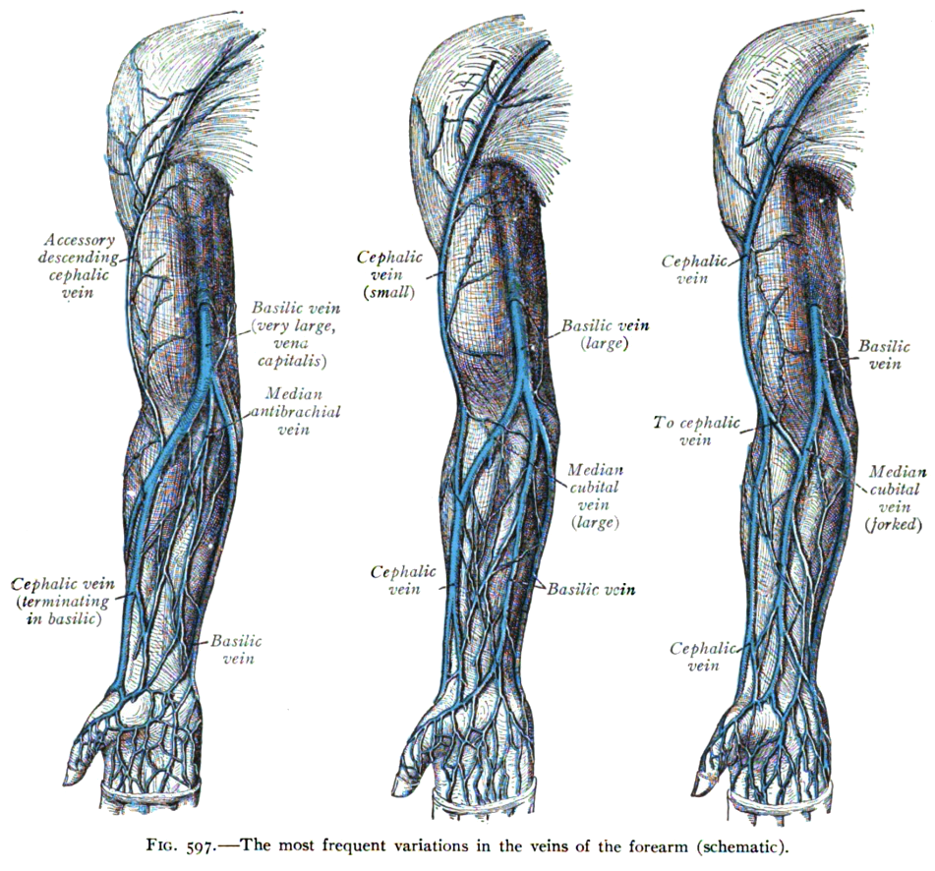

https://commons.wikimedia.org/wiki/File:Sobo_1909_597.png

Slide 9
Upper Limb DVT
Anatomy refresher – upper limb and neck veins
Common reasons for referral
Clinical signs and symptoms
Pathology and differentials to consider
Video live demonstrations of technique x 4

Slide 10
Common reasons for referral
Cancer – chest, lung, breast, lymphoma
Trauma and Procedural Misplacement
(chemotherapy catheters, central and PICC lines)
Inflammation, infection, in situ line thrombosis
External/extrinsic venous compression or trauma. Paget-Schroetter syndrome (PSS) – rare!
Typically, young athletes get PSS in the arm they use most for sports like swimming or tennis. When you do the same motion over and over, the veins in your neck and shoulder get squeezed. This can trigger a clot.

Slide 11
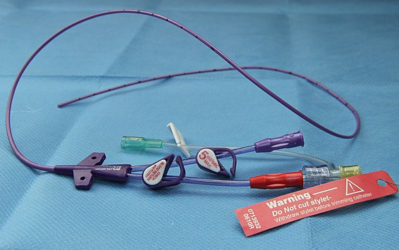
PICC line thrombosis
https://commons.wikimedia.org/w/index.php?title=File:PICC_line.jpg&oldid=441711399

Slide 12
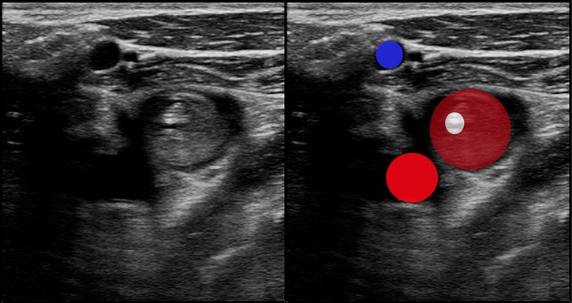
Upper extremity deep vein thrombosis: a complication of an indwelling peripherally inserted central venous catheter
Figure 4
Dual images (original left; legend right).
A transverse view of the axillary vein with PICC in place, surrounded by echogenic thrombus that is distending the vein (dark red). The axillary artery (red) and cephalic vein (blue) are also seen.
Clinical Case Reports, Volume: 3, Issue: 3, Pages: 170-174, First published: 22 January 2015, DOI: (10.1002/ccr3.187)
Upper extremity deep vein thrombosis: a complication of an indwelling peripherally inserted central venous catheter. Peter J. Carr. James C. R. Rippey First published: 22 January 2015. https://doi.org/10.1002/ccr3.187
Notes:
Dual images (original left; legend right). A transverse view of the axillary vein with PICC in place, surrounded by echogenic thrombus that is distending the vein (dark red). The axillary artery (red) and cephalic vein (blue) are also seen.
IF THIS IMAGE HAS BEEN PROVIDED BY OR IS OWNED BY A THIRD PARTY, AS INDICATED IN THE CAPTION LINE, THEN FURTHER PERMISSION MAY BE NEEDED BEFORE ANY FURTHER USE. PLEASE CONTACT WILEY'S PERMISSIONS DEPARTMENT ON PERMISSIONS@WILEY.COM OR USE THE RIGHTSLINK SERVICE BY CLICKING ON THE 'REQUEST PERMISSIONS' LINK ACCOMPANYING THIS ARTICLE. WILEY OR AUTHOR OWNED IMAGES MAY BE USED FOR NON-COMMERCIAL PURPOSES, SUBJECT TO PROPER CITATION OF THE ARTICLE, AUTHOR, AND PUBLISHER.

Slide 13
Upper Limb DVT
Anatomy refresher – upper limb and neck veins
Common reasons for referral
Clinical signs and symptoms
Pathology and differentials to consider
Video live demonstrations of technique x 4

Slide 14
Clinical signs and symptoms
Swollen arm
Dilated veins on the anterior chest wall
Swelling, tenderness, erythema and pain
Palpable superficial veins in the neck

Slide 15
Upper Limb DVT
Anatomy refresher – upper limb and neck veins
Common reasons for referral
Clinical signs and symptoms
Pathology and differentials to consider
Video live demonstrations of technique x 4

Slide 16
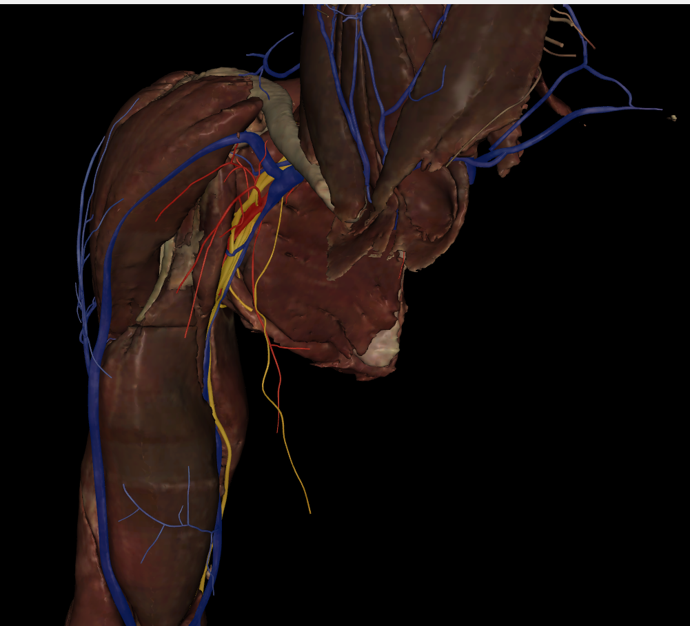
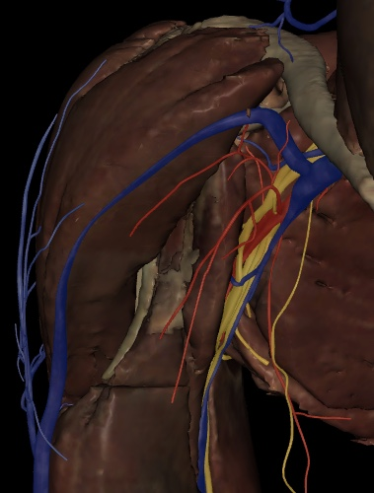
Nerves in the Axilla – credit Deborah Patten

Slide 17
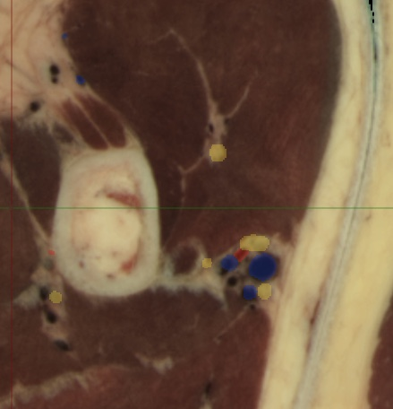
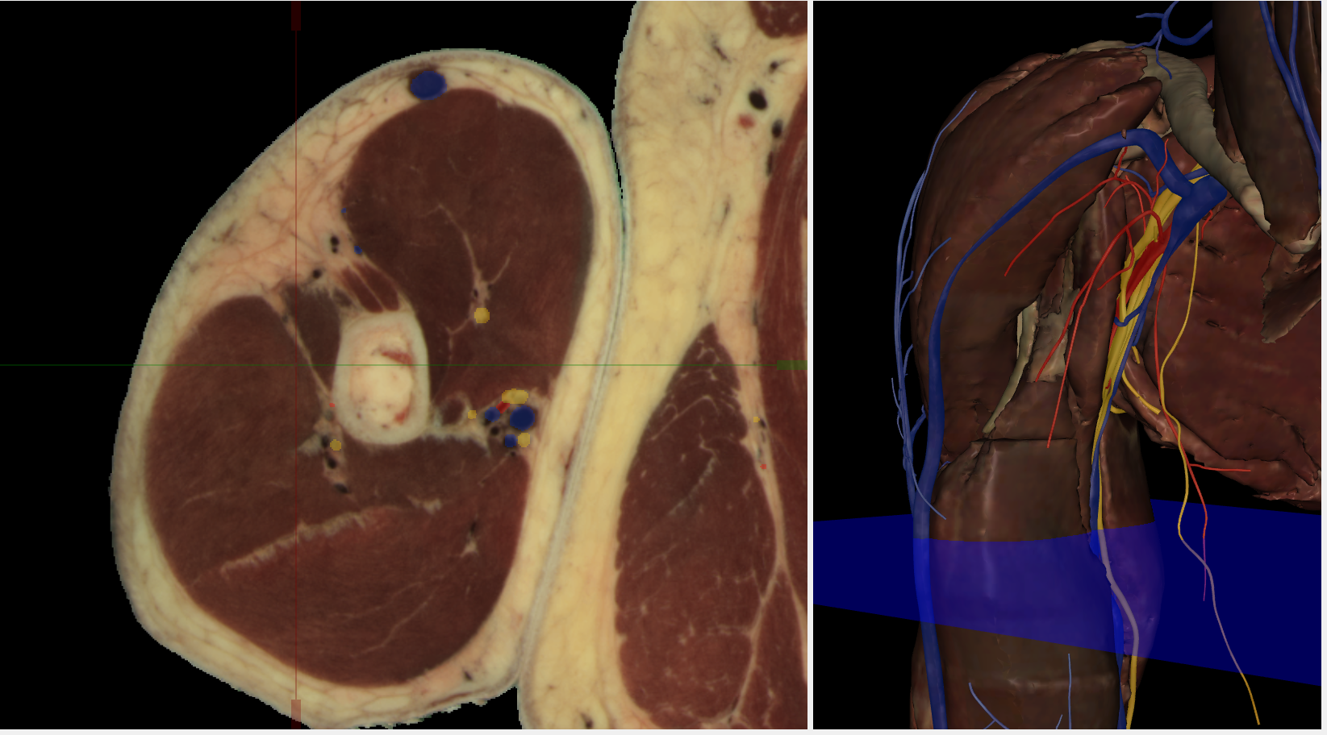
Nerves in the Axilla – credit Deborah Patten

Slide 18
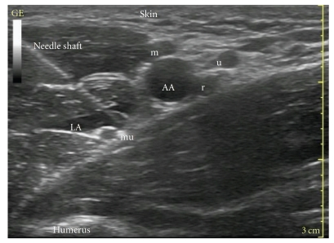
Nerves in the Axilla
Axillary brachial plexus block. Satapathy AR¹, Coventry DM
Anesthesiology Research and Practice, 22 May 2011, 2011:173796
DOI: 10.1155/2011/173796 PMID: 21716725 PMCID: PMC3119420
Figure 2
Ultrasound scan of axilla. AA: axillary artery, LA: local anaesthetics, r: radial nerve, mu: musculocutaneous nerve, m: median nerve, and u: ulnar nerve. This is an in-plane approach, with the whole length of the needle shaft visible under ultrasound.

Slide 19
Pathology and differentials to consider
Upper-extremity deep venous thrombosis (DVT) refers to thrombosis of the internal jugular, brachiocephalic, brachial, subclavian, and/or axillary veins.
Usually the thrombotic process involves more than 1 venous segment, with the subclavian vein most frequently affected.
The internal jugular vein, the brachiocephalic vein, and the basilic vein are additionally involved in up to 20% to 30% of these patients.
Upper-extremity DVT is far less common than lower-extremity DVT but still may account for as much as 10% of DVTs. The annual incidence of upper-extremity DVT is 0.4 to 1 case per 10,000 people, but may be increasing in frequency because of the use of indwelling central venous catheters as well as cardiac pacemakers and defibrillators.
Compared to patients with lower-extremity DVT, upper-extremity DVT patients are typically younger, more likely to have a diagnosis of cancer, and less likely to have thrombophilia.
Cancer is found in up to 40% of patients with upper-extremity DVT.
Upper-extremity deep venous thrombosis
Presentation, complications, diagnosis, and treatment are among the topics covered. By David Cohen, MD, FACP. https://acphospitalist.org/archives/2016/03/expert-analysis-deep-venous-thrombosis.htm

Slide 20
Live Demonstrations

Slide 21
PART 1: Introduction and Internal Jugular Vein (IJV)
PART 2: The Arm
- brachial, radial, ulnar, basilic and cephalic veins
PART 3: The axilla and axillary veins
PART 4: Subclavian and Brachiocephalic Veins

Slide 22

Have we answered all your questions?
Thank you to Rick Miles
if not then….tell us
☺ 😐 ☹

Slide 23
LIVE
Question and Answer Session

