Slide 1

Compression PoCUS for DVT
#POCUSClubInternational
Sponsored by
Borsha Sarker
Clinical Specialist Sonographer
DCR. DMU. AVS. MHSc.
gECHO ultrasound solutions ltd.
NIHR Leeds Biomedical Research Centre
borsha@squeeakybird
borsha.sarker@nhs.net

Slide 2
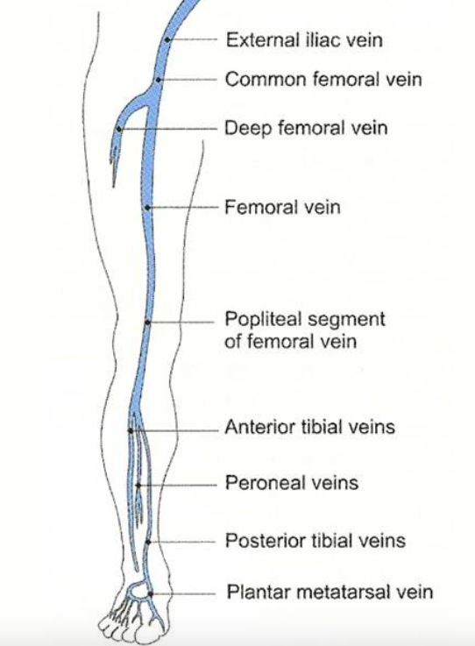
Which ultrasound technique?
2 point compression
3 point compression
5 point compression
Full leg using Doppler and compression?
Notes:
I explain that full ‘radiology’ exam is best as it is 97% sensitive but that 2 point and 3 point are nearly as good and the sensitivity of the two methods are the same so it doesn’t matter really whether you want to do 2 or 3 point technique. The red stars in the diagram represent transducer position.

Slide 3
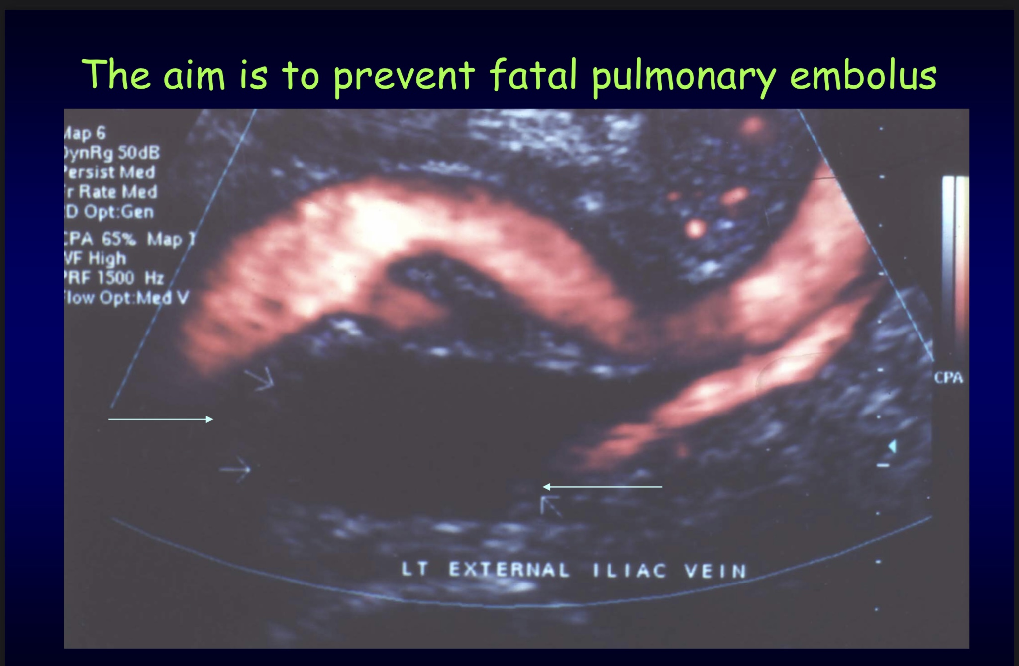

Slide 4
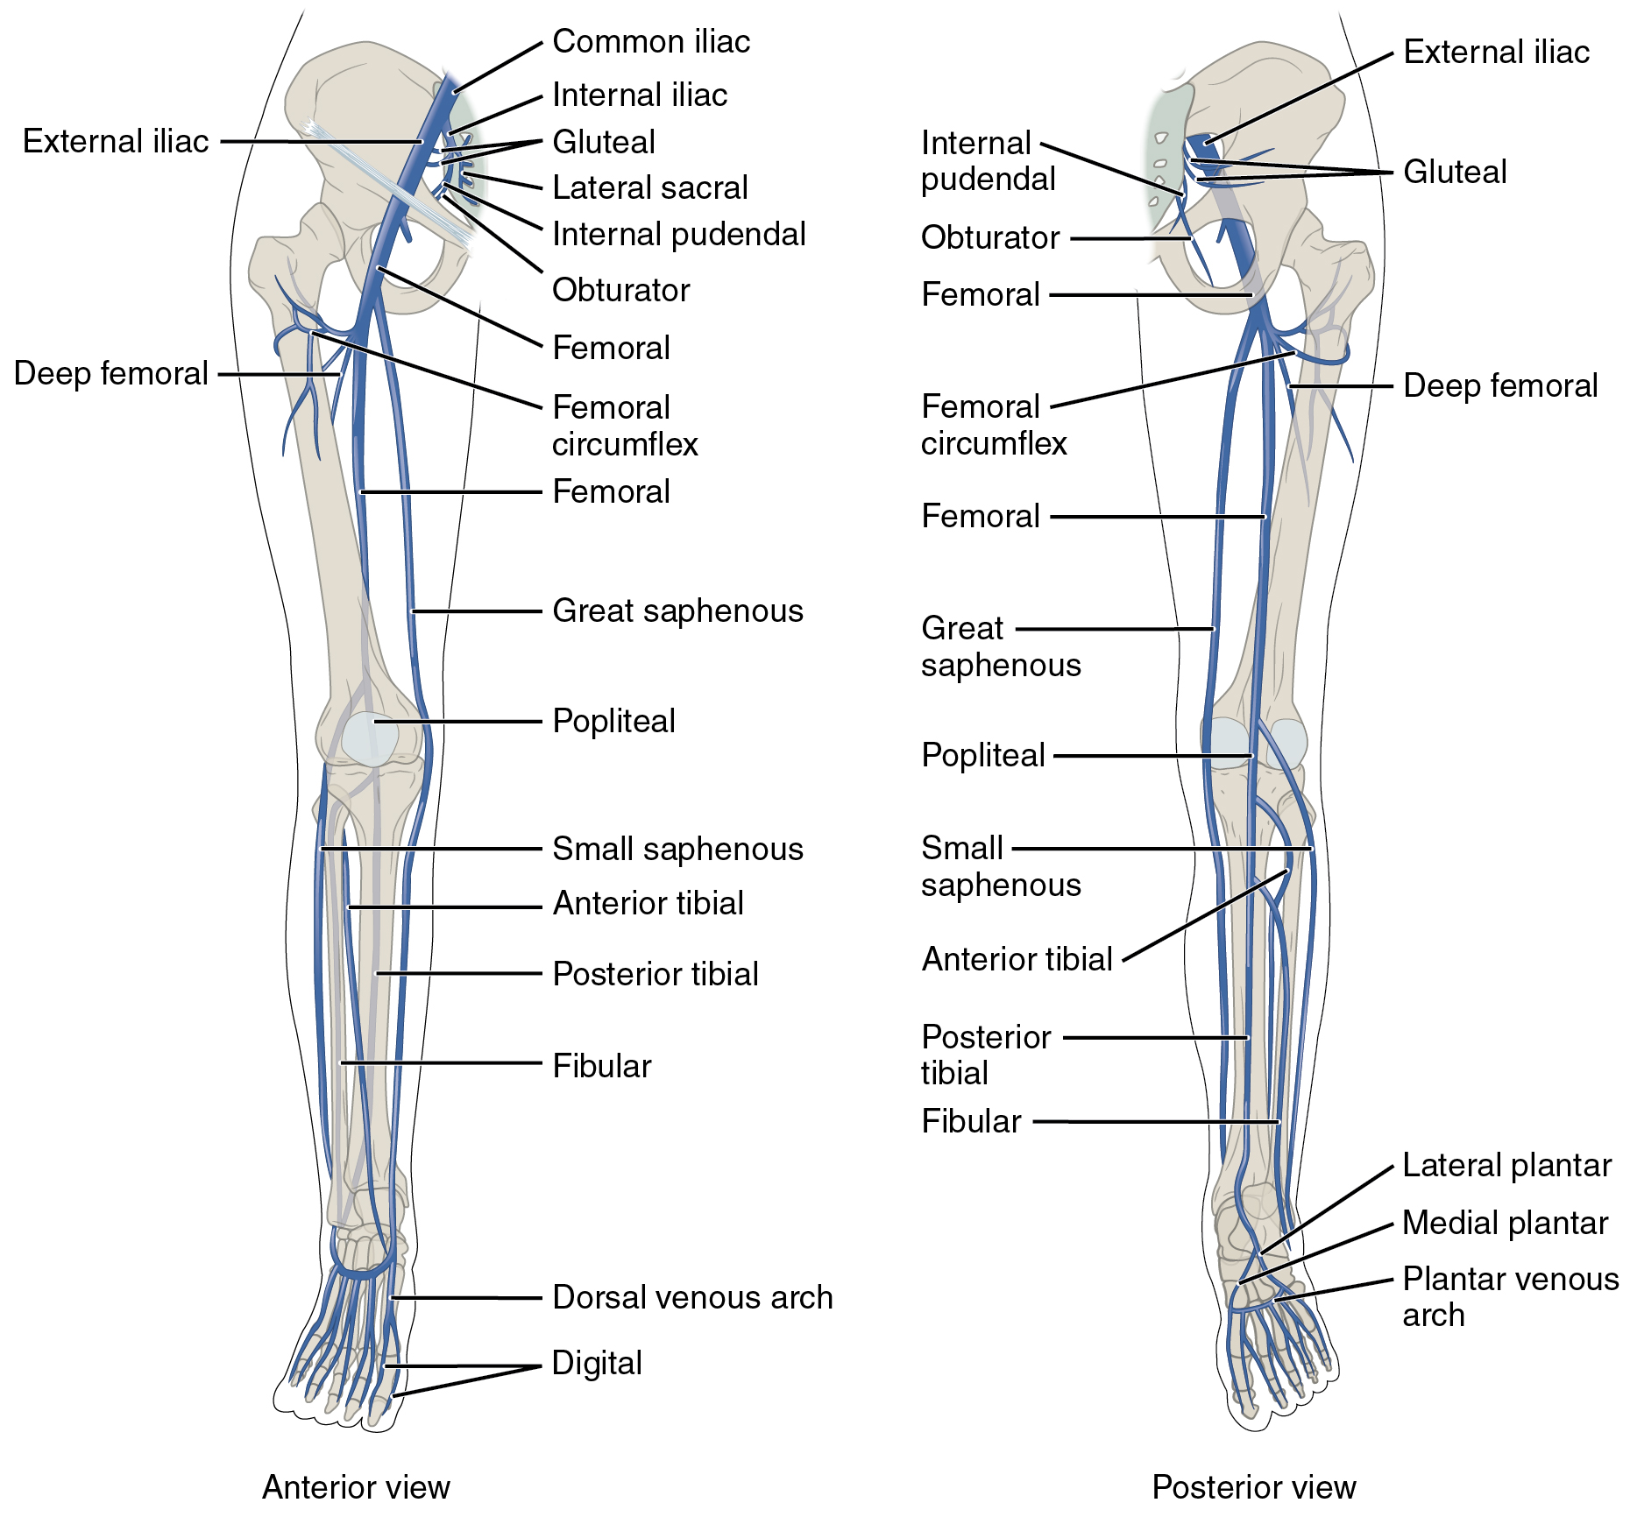
Compression PoCUS for DVT
https://en.m.wikipedia.org/wiki/File:2136ab_Lower_Limb_Veins_Anterior_Posterior.jpg

Slide 5
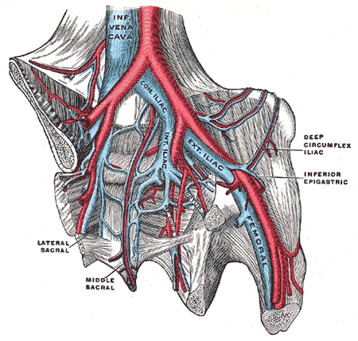
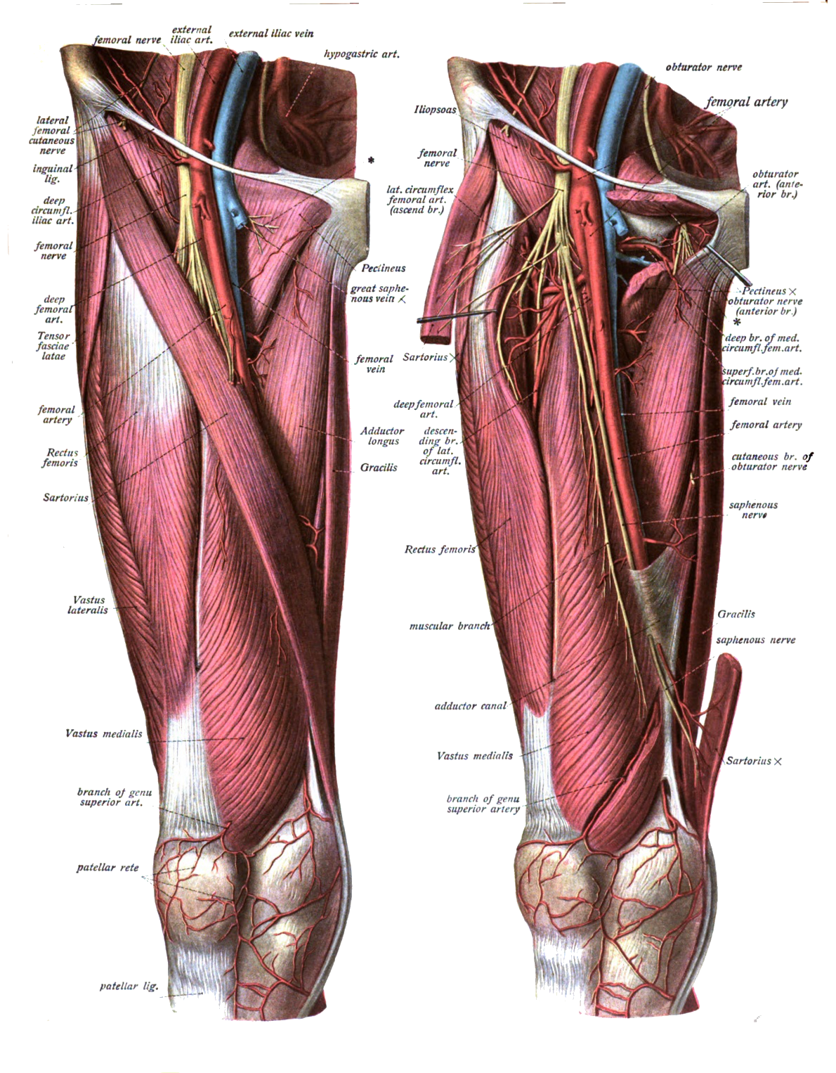
http://us.i1.yimg.com/us.yimg.com/i/edu/ref/ga/l/586.gif. . https://commons.wikimedia.org/wiki/File:Sobo_1909_573-574.png

Slide 6
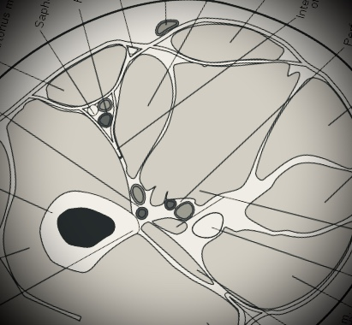
Effective Compression of the Femoral V
Transducer
Transducer
Gracilis
Sartorius
Add. Longus
A. Magnus
Vastus
Linea Aspera

Slide 7
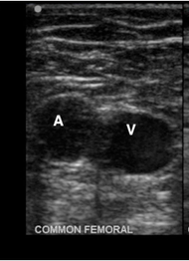
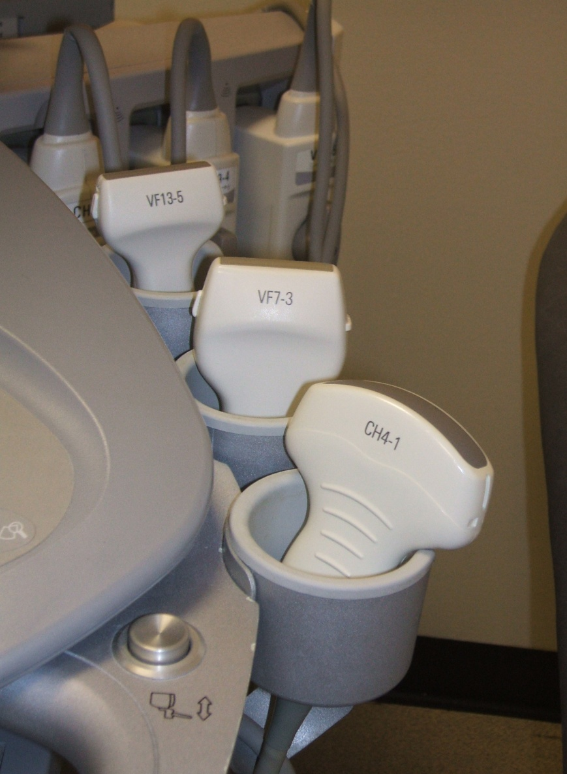
2, 3 or 5 point compression technique
Linear Transducer
– low frequency
Curved Transducer
– high frequency
Patient semi-recumbent (1)
Groin & thigh exposed
Externally rotated leg
Compress only in transverse
Sit patient bolt upright (2)
Compress towards bone
Notes:
I explain why it’s dangerous to attempt compression in longitudinal.

Slide 8
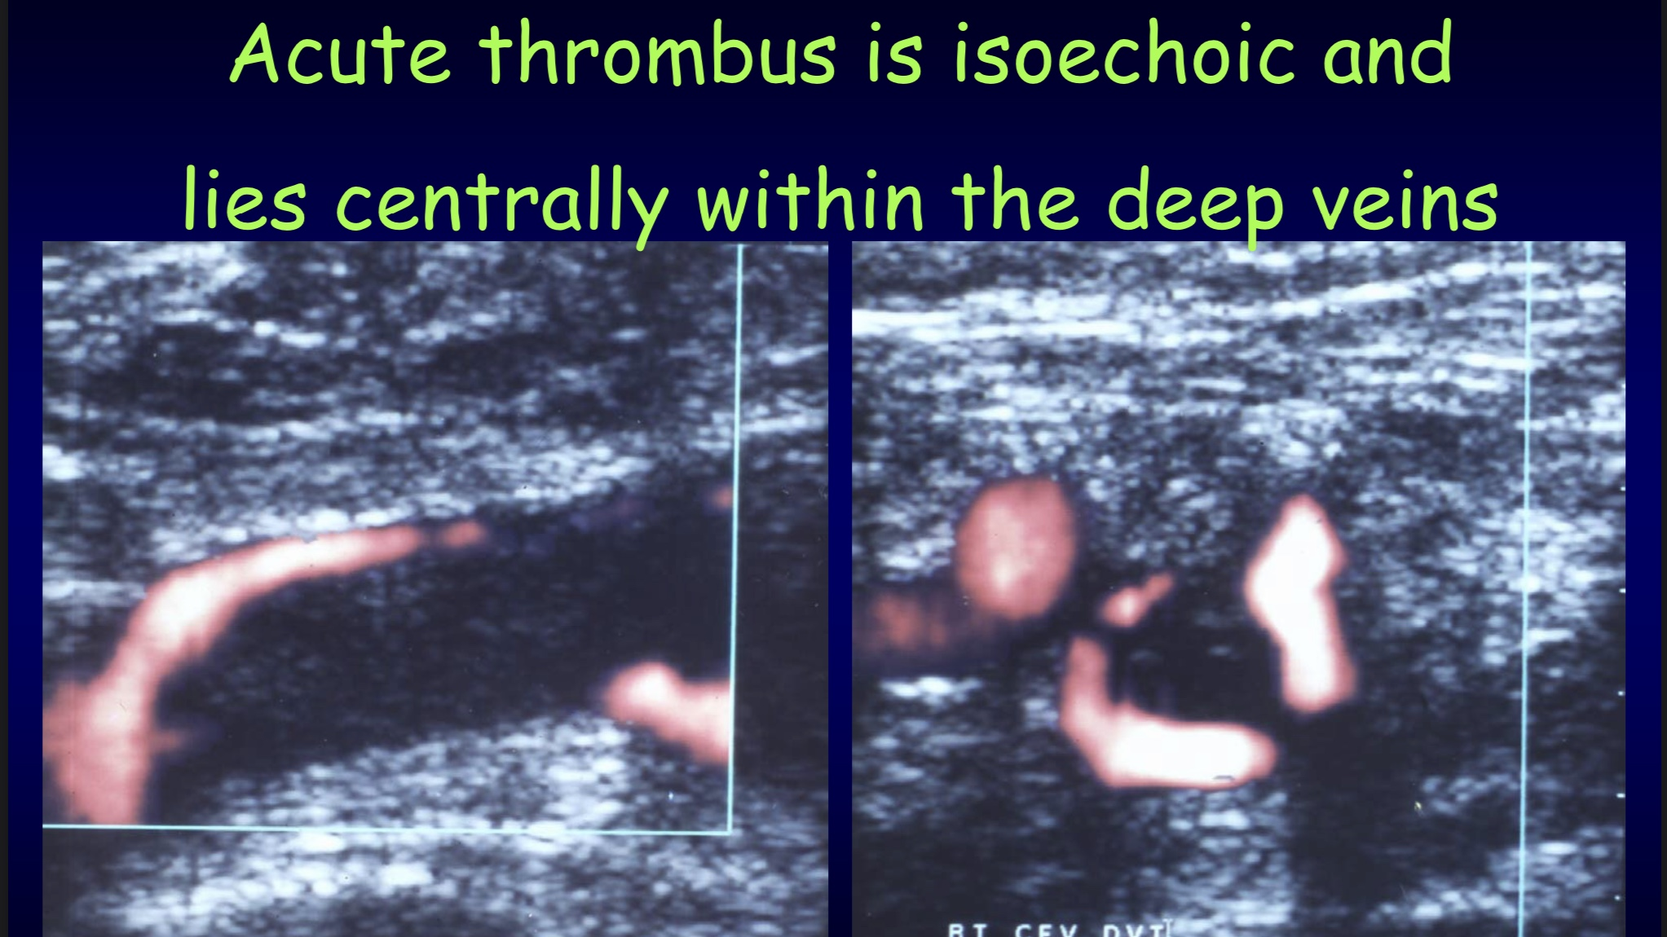

Slide 9
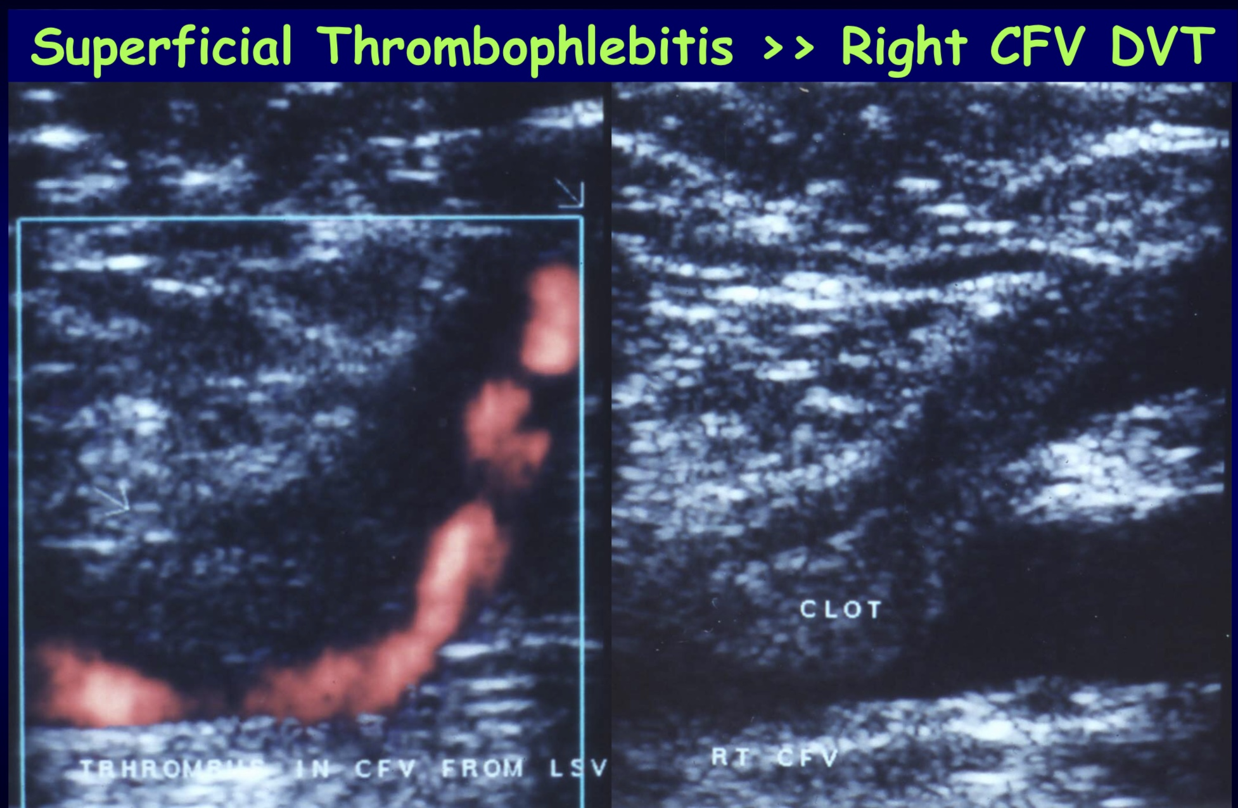

Slide 10
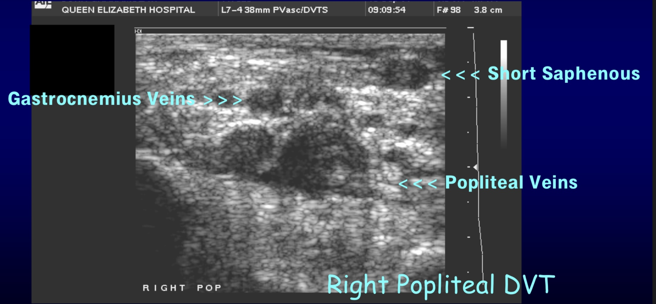

Slide 11
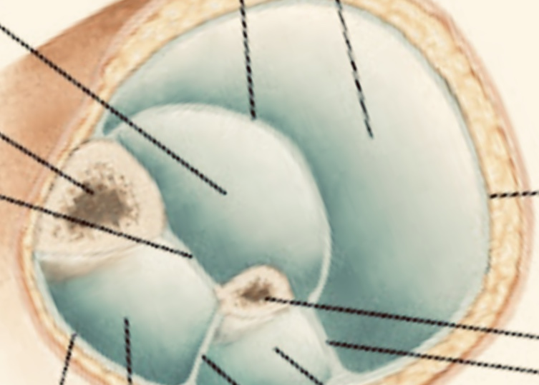
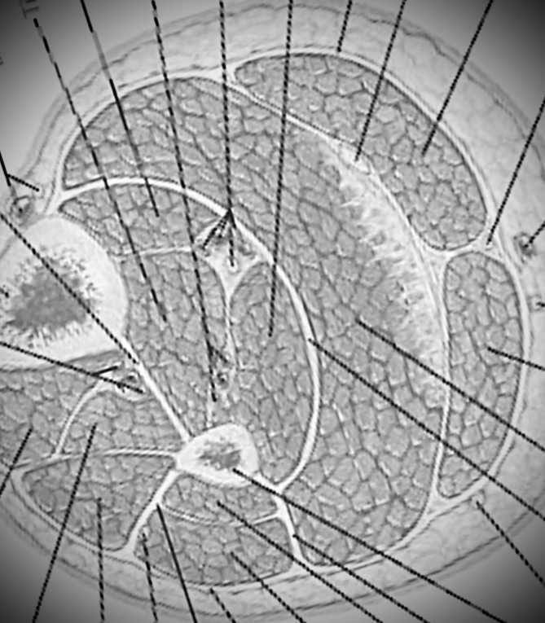
Effective Compression of the Deep Posterior Compartment
Deep Post Compartment
Transducer 1
Tibia
Superficial Posterior Compartment
FDL
FHL
TP
Gastr
Tx 2
Fibula
Gastr
Soleus

Slide 12
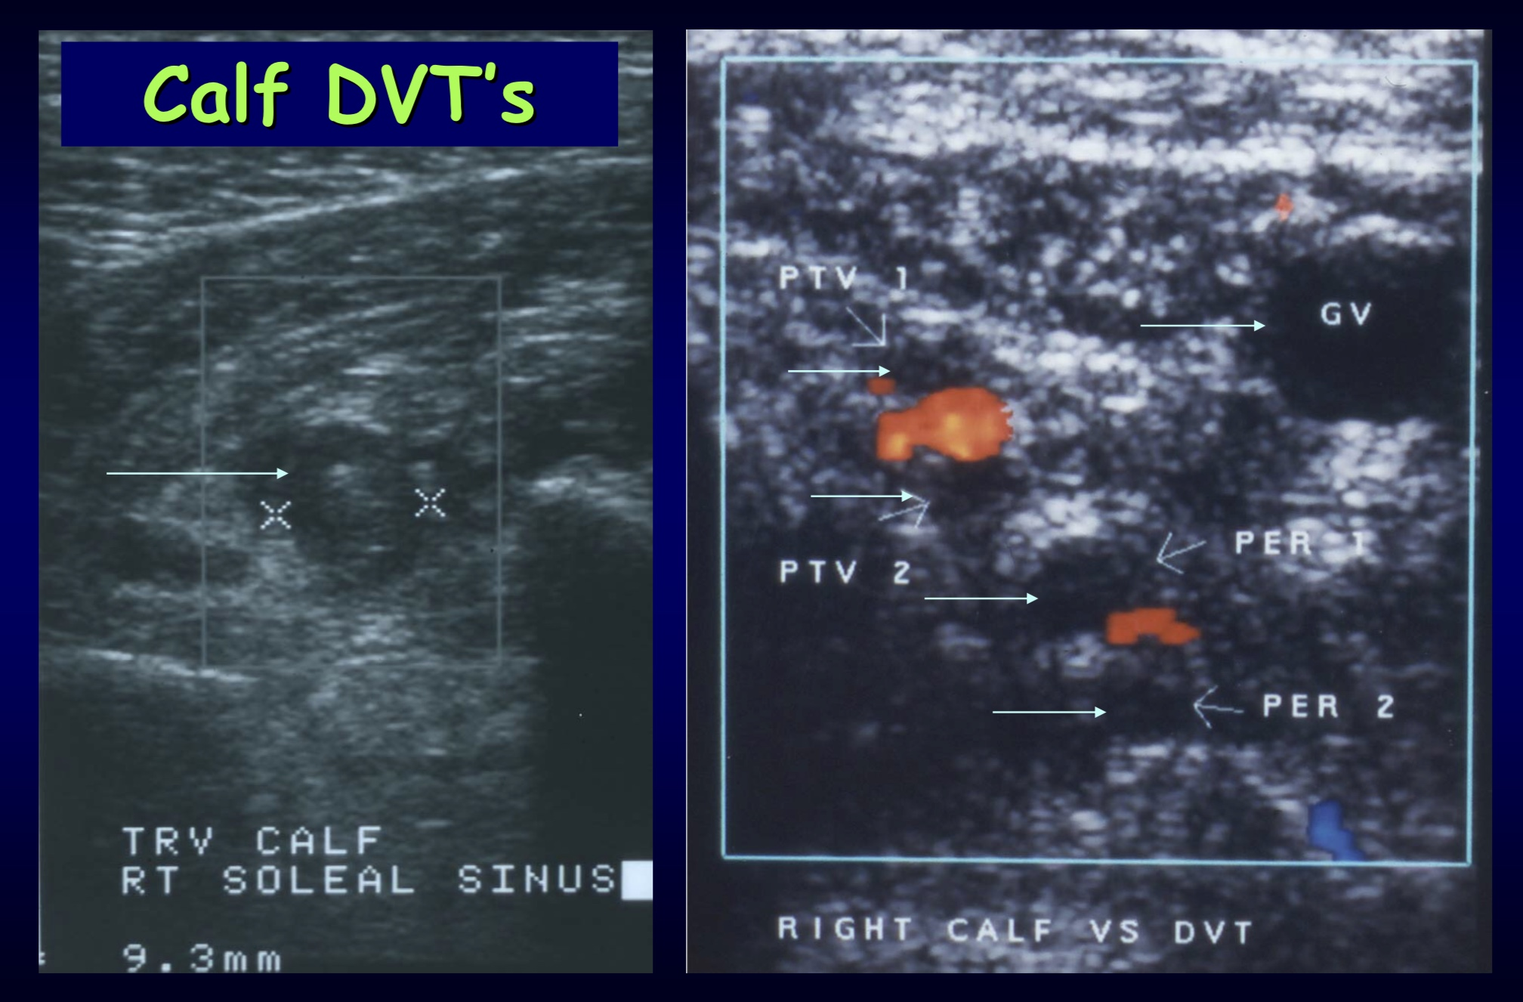
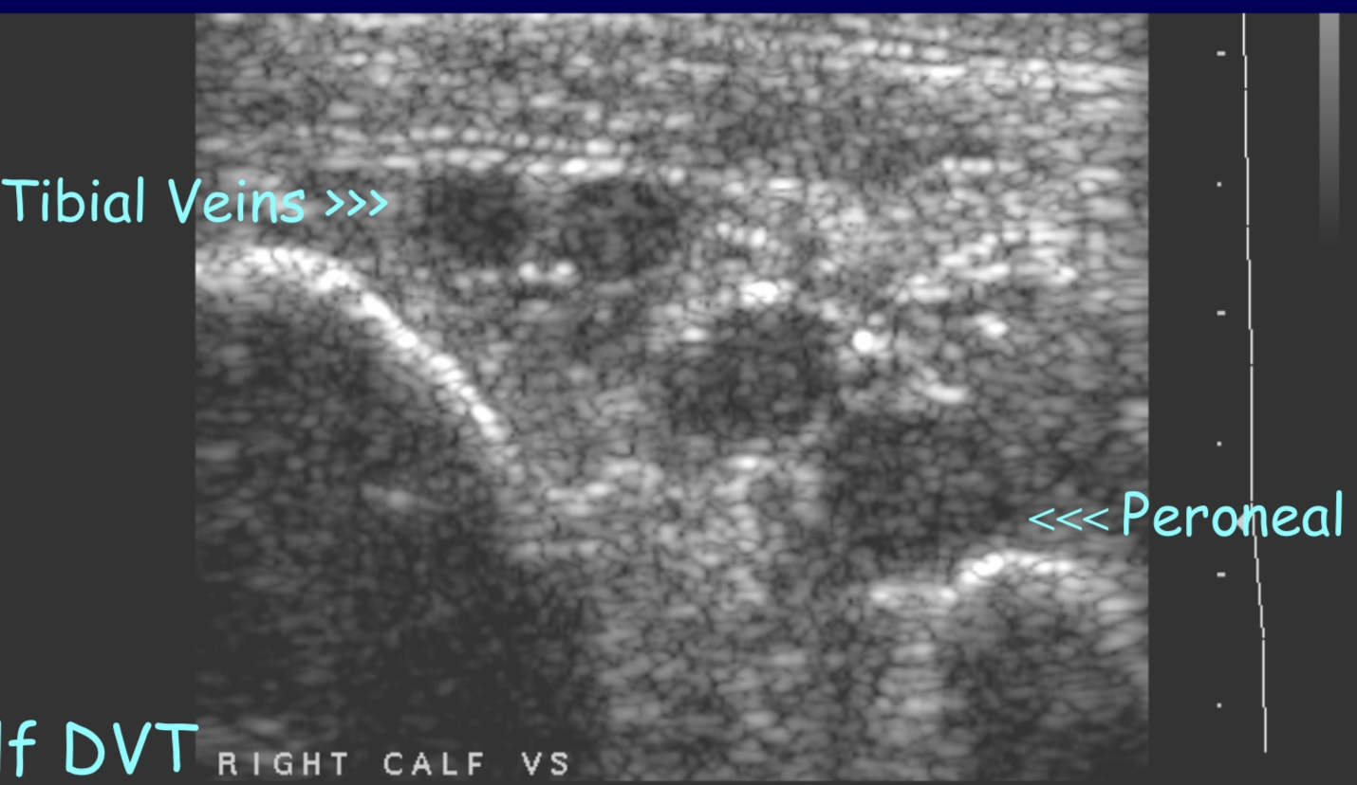
Alternative Causes of Calf Swelling
– FIRST think calf DVT !

Slide 13

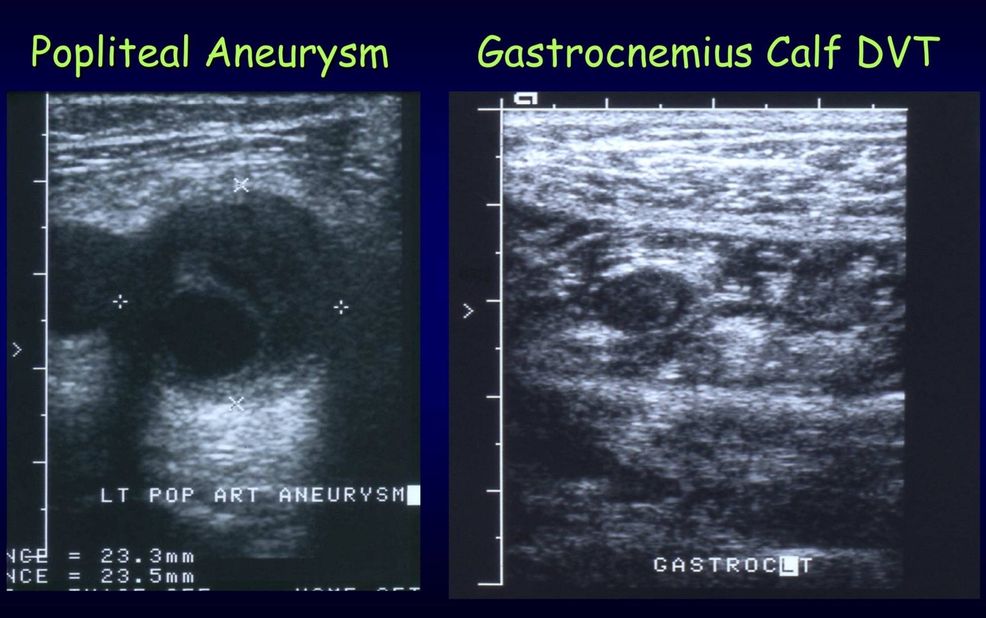
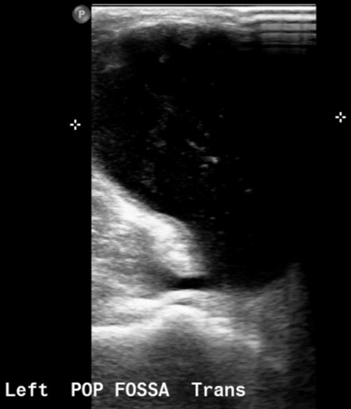
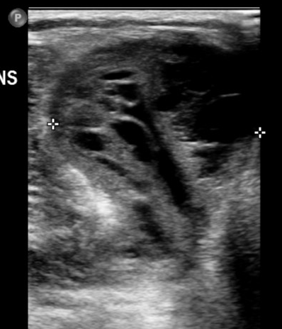
Alternative Causes of Calf Swelling
Baker’s cyst +/- haemorrhage
MSK injuries / Popliteal artery aneurysm
Muscular vein DVT / muscle tears
Baker’s cyst
Notes:
Medial head of gastrocnemius muscle and semimembranosus tendon. I explain the classic shape of a Baker’s and difference between simple and haemorrhagic.

Slide 14
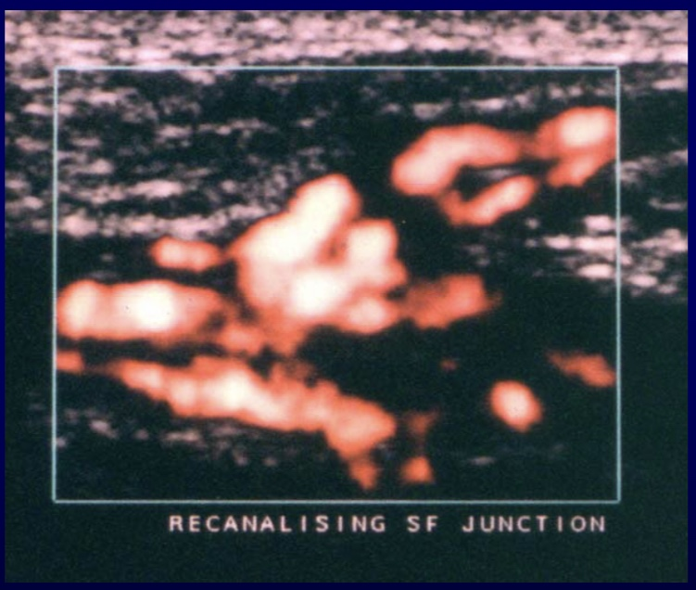
Pitfalls
H/O previous thrombosis
H/O SFJ ligation (landmarks)
Abdominal pathology ?
Already a Pulmonary Embolus ?
Oedema / Cellulitis
Isolated thrombus
Vein duplications
Confusing Terminology - avoid ‘SFV’ instead use FEMORAL vein
IVDU – beware pelvic thrombus
Notes:
This slide shows non-occlusive thrombus at the SFJ. Using term SFJ can mislead referrers and mean patients don’t get anticoags.

Slide 15
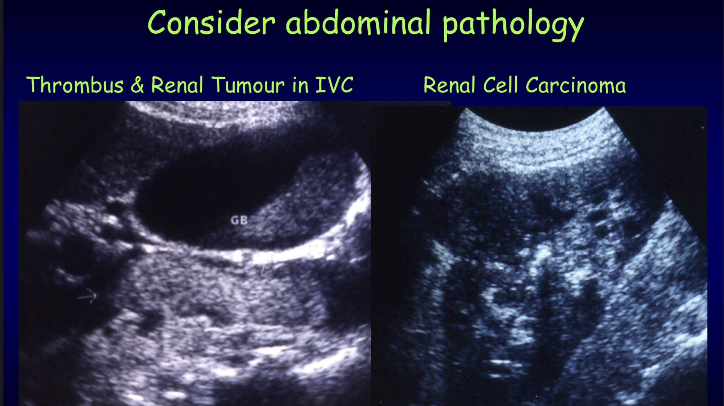

Slide 16
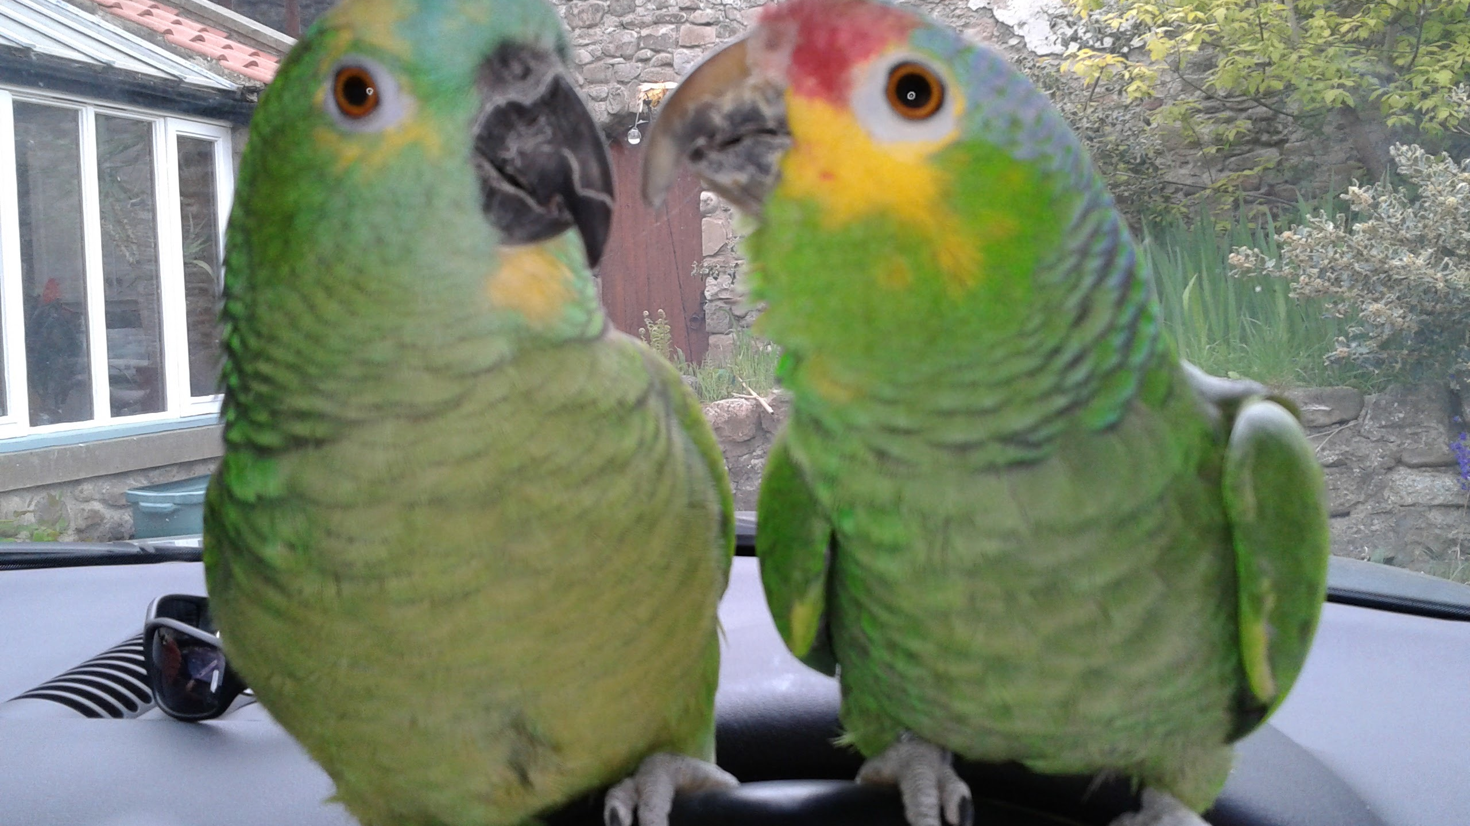
Thank you for listening ☺ Thanks for additional images from Hazel Edwards and Simon Richards Thank you to Rick Miles

